Slide 1

Introduction to algorithms
homework
Semester 1, 2021

Slide 2
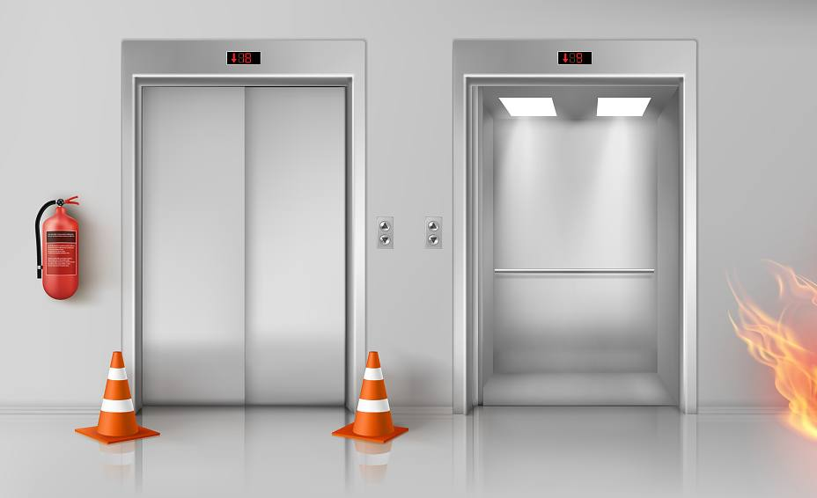
Two elevators
Imagine a tall building with n floors and two lanes of elevators E1 and E2.
Assume that a person is in level x and wants to use the elevator.
Upon pressing the elevator button, which one of
the elevator lanes (E1 or E2) should be sent to floor x?
Can you write the algorithm??
HINT: you might need to write a sub-algorithm to find the absolute value of a number. Can you say why??

Slide 3
Two elevators – improved scenario
Going down uses less energy compared to moving upwards.
Assume:
going down 2 levels is equivalent to moving up 1 level
Example:
E1=6, E2=13, x=9
abs(E1-x)=3, abs(E2-x)=4
4/2=2<3
return E1 or E2 ??
Can you write the algorithm for this scenario??

Slide 4
Bring your algorithm with you to your seminar session!!
We will discuss
this problem
in seminar 3.

